Slide 1

Protokol-Indonesia
Blockchain-base supplay chain technology

Slide 2


`
Problems
Quality control of industrial products that require high trust from the customer through direct verification ...
Involvement is open to anyone to verify whether an industrial product meets the industry standards for the product it produces
Safety in terms of counterfeiting of products, inappropriate or dangerous contents, against sensitive products in the wider community ...
The centralized supply chain control and supervision system makes it vulnerable to cyber actions that can undermine global product distribution chain trusts
Blockchain-base supplay chain technology

Slide 3
Solution: Create blockchain consorsium and wallet application for replacing single control tower centralized to decentralized, distributed and peer to peer verification line
Blockchain-base supplay chain technology

Slide 4
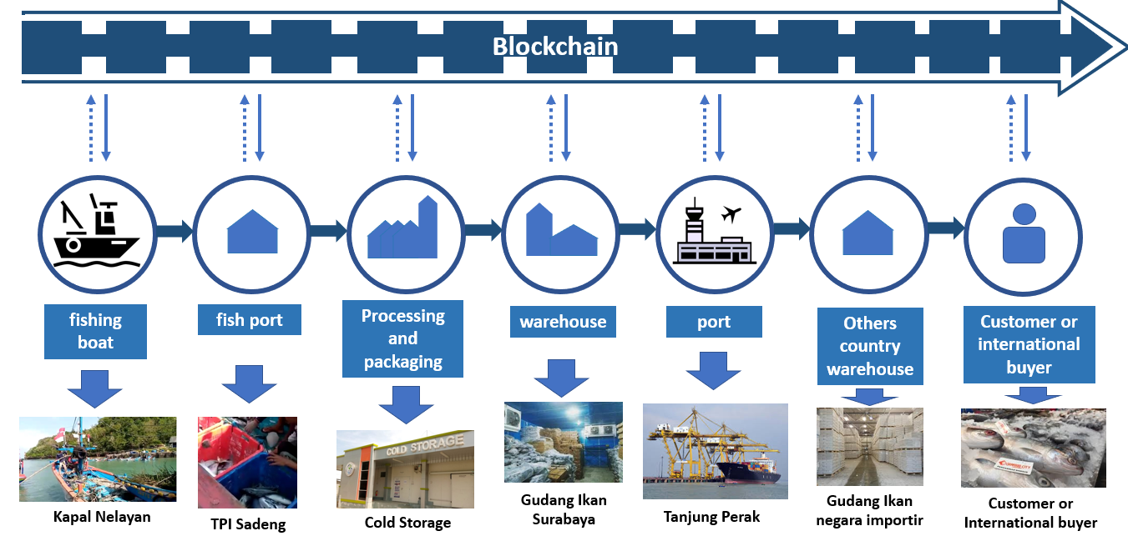
Solution: Create blockchain consorsium and wallet application for replacing single control tower centralized to decentralized, distributed and peer to peer verification line
Blockchain

Slide 5
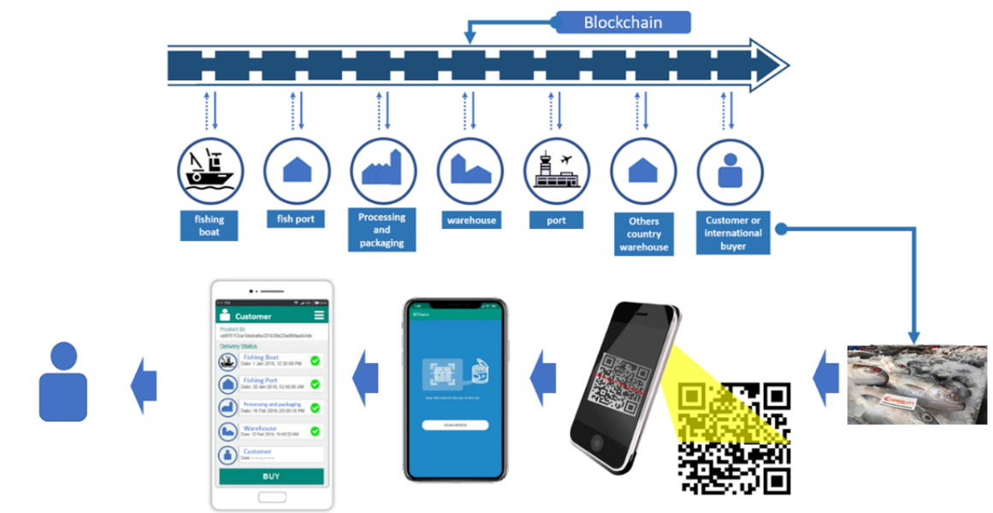
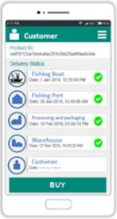
Solution: Create blockchain consorsium and wallet application for replacing single control tower centralized to decentralized, distributed and peer to peer verification line

Slide 6
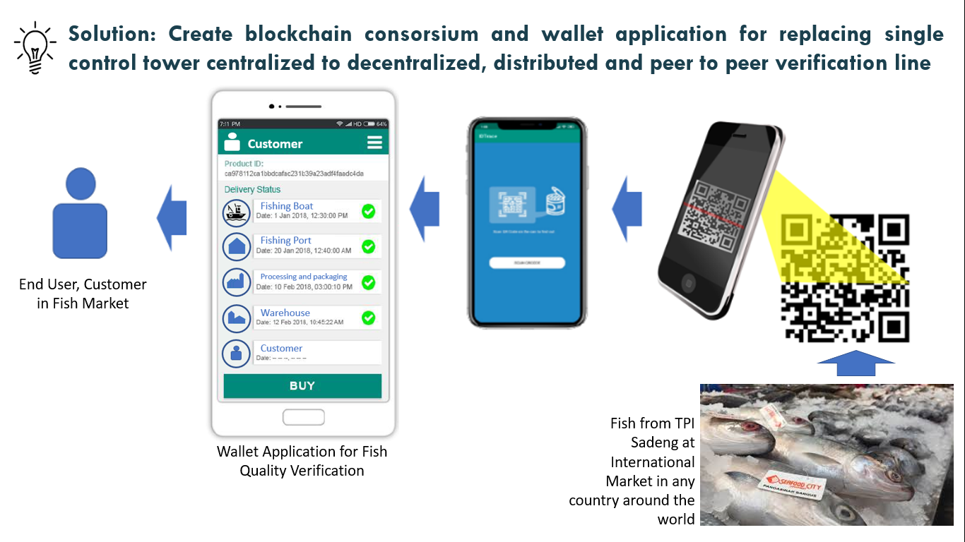
Solution: Create blockchain consorsium and wallet application for replacing single control tower centralized to decentralized, distributed and peer to peer verification line

Slide 7
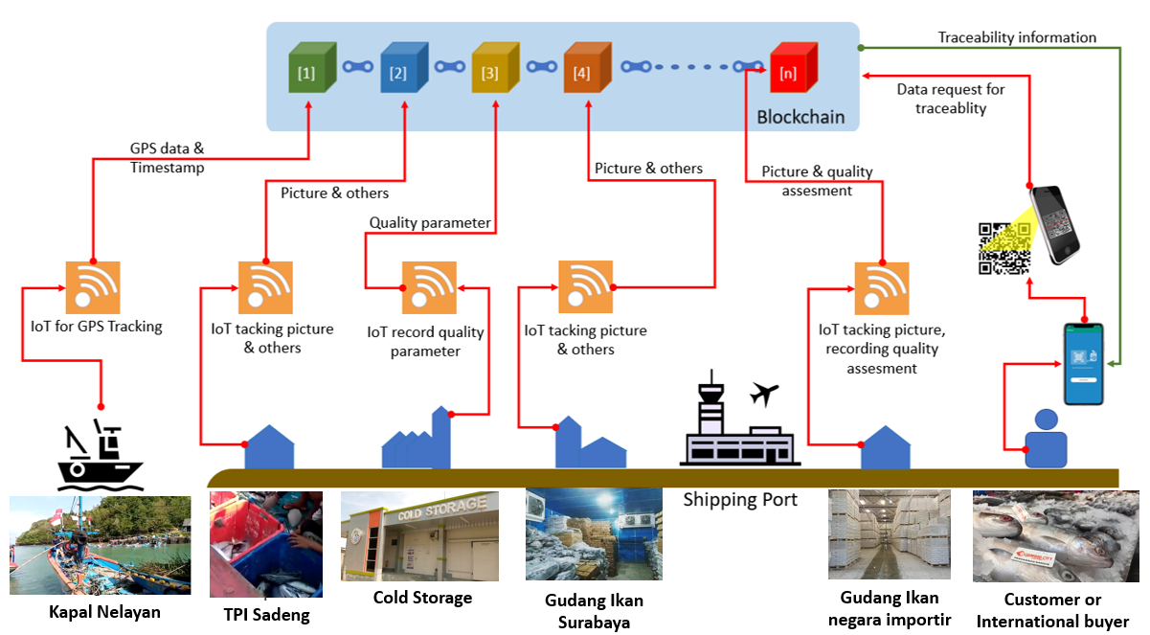
Data acquisition uses IoT

Slide 8
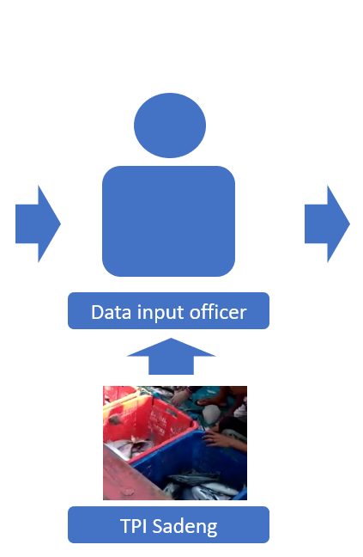
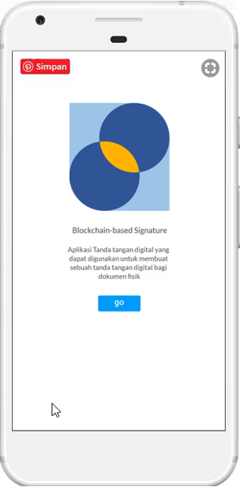
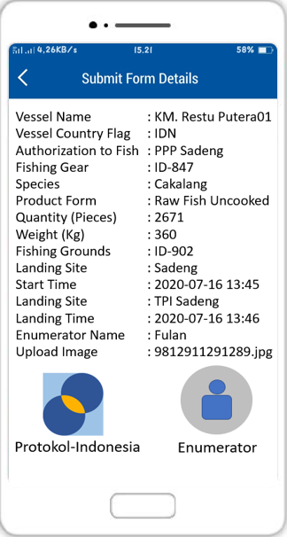
Data acquisition uses Person and Digital Signature

Slide 9
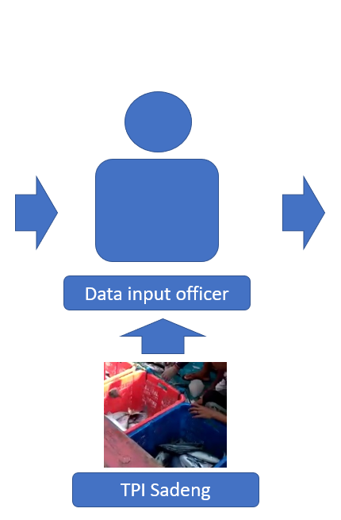


Verification for Data acquisition

Slide 10
Verification for data acquisition
Every inputer
Involvement is open to anyone to verify whether an industrial product meets the industry standards for the product it produces
Safety in terms of counterfeiting of products, inappropriate or dangerous contents, against sensitive products in the wider community ...
The centralized supply chain control and supervision system makes it vulnerable to cyber actions that can undermine global product distribution chain trusts

Slide 11


Our Unique Values
NO THIRD PARTY
hash
1
hash
2
No third party carries out additional regulation, thereby increasing the cost of the supply chain infrastructure
hash
2
RELIABLE
RELIABLE is that this technology is based on cryptographic technology and blockchain protocol so as to provide a scientific TRUST.
hash
2
hash
3
SECURE & TRUSTED
Services running on blockchain are known to have relatively secure protocols compared to other protocols
RESILIANCE
RESILIANCE is that all data is resistant to natural disasters, server damage, fires and so on because of its distributed nature, ie there are many people who hold the copy, so that damage in one node can still be recovered by copying from another node.
$
$
$
$
$
$
GLOBAL SERVICES
$
$
$
Services can be accessed regionally and globally throughout the world
$
REDUCE COST
Reducing the cost of both public services and supply chain infrastructure
This Photo by Unknown Author is licensed under CC BY-SA
Blockchain-base supplay chain technology

Slide 12

Technology Comparison
Blockchain consorsium, more secure for more company involved
Company supplay chain infrastructure by every industry
Integrated information system
Centralized verification, and manual checking for standar regulation by government
Peer to peer verification and open to verify for every time by every one

Slide 13
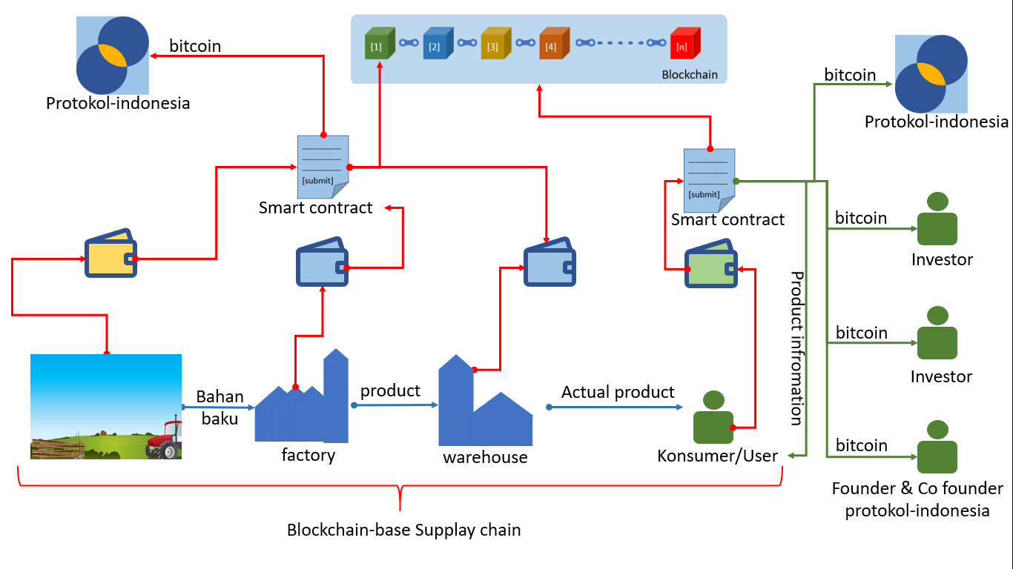
Revenue Model Secara Umum

Slide 14

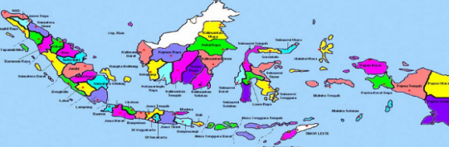
Potential Market
Industry manufacture
Government
Others
This Photo by Unknown Author is licensed under CC BY-SA
Indonesia manufacture
Blockchain-base supplay chain technology

Slide 15
Market Valuation :
Global Industry
TAM
SAM
Nation industry
SOM
Local industry

Slide 16
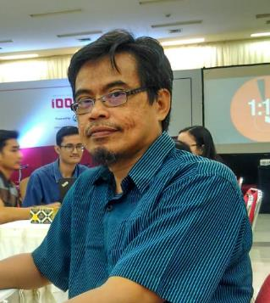
Founder
Aslan
CEO/Founder
PhD Computer Science
Email : aslan.alwi@yahoo.co.id, aslan.alwi@mail.ugm.ac.id, elangbijak4@gmail.com
Facebook : https://www.facebook.com/elangbijak4
Linkedin : https://id.linkedin.com/in/aslan-alwi-99935a73
Github Profile : https://github.com/elangbijak4
Website : https://aslanalwi.wordpress.com

Slide 17
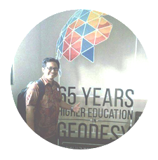
Co-Founder
Doctoral Student at Geomatics Engineering Gadjah Mada University Master of Science (M.Sc.) (2009 – 2011)
Master of Science Linkage Program Geo-Information for Spatial Planning and Disaster Risk Management Gadjah Mada University, Yogyakarta and Faculty of Geo-information Science and Earth Observation, ITC, Twente University, Enschede The Netherlands.
Geodetics and Geomatics Engineer (S1) (1997-2002)
Geodetics and Geomatics Engineering of Faculty of Engineering, Gadjah Mada University, Yogyakarta, Indonesia
Koes
CTO/Co-Founder
Doctoral Student @Geomatics
kusmiarto@stpn.ac.id; kusmiarto@mail.ugm.ac.id
WORK EXPERIENCES
Dates: 2004-February 2012
Staff of Surveying and Mapping Division of Regional Office of BPN NTB
Main Activities and Responsibilities:
Organizing Cadastral Maps into Land Information System
Dates: February 2012 – November 2012
Head of Surveying and Mapping Sub-Section, Land Office of Mataram City
Main Activities and Responsibilities:
Controlling the Quality of the result of Cadastral Surveying and Mapping
Technical Coordinating of Cadastral Surveying and Mapping
Dates: December 2012 – Current
Lecturer at National Land Institute (Sekolah Tinggi Pertanahan Nasional/STPN)
Main Activities and Responsibilities: Teaching Subjects related to Cadastral Surveying
Dates: 2018 – Current
Co-Founder Protokol Indonesia
PROJECT EXPERIENCES
As a Technical Coordinator in Reconstruction of Aceh Land Administration System Project (RALAS). The RALAS is a Project financed by the World Bank and Multi-Donor Trust Fund (MDTF), carried out in Aceh after Tsunami Disaster;
As a Supervisor of Pilot Project of PaLaR (Participatory Land Registration), Collaboration of Ministry of ATR/BPN, UGM, JKPP, Meridia, World Bank and The Netherlands Cadastre;
Fasilitator of Gerakan Nasional 1000 StartUp Digital-Yogyakarta

Slide 18
The Protokol Team
Aslan
CEO/Founder
PhD Computer Science
Koes
CTO/Co-Founder
Doctoral Student @Geomatics

Slide 19
© Protokol_Indonesia
Thank you
Protokol-Indonesia
Blockchain-base supplay chain technology

